Slide 2
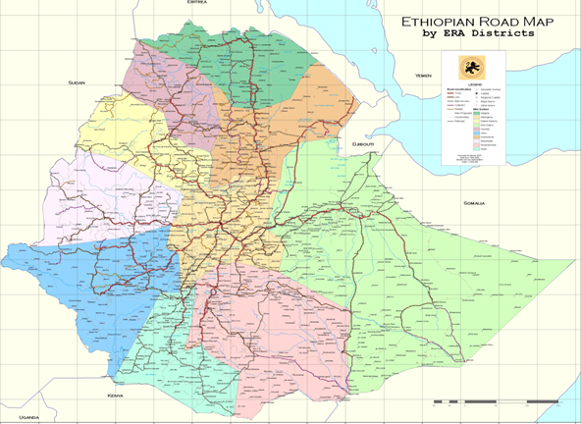
INTRODUCTION TO ETHIOPIAN BRIDGES
ERA - Bridge Management Team
Engr. Girma Worku ERA Bridge Mgt Team Leader
October 2019 Addis Ababa, Ethiopia

Slide 3
Welcome to Ethiopian Roads Authority
Vision
Global Competence and great Roads to Prosperous Ethiopia by 2030
Mission
Develop and Manage Sustainable Roads through institutional competency and Optimal utilization of resources
Motto
Best Roads for Prosperous Ethiopia
Value
Candor, Family, School, Army, Sustainability, Excellence and Innovation

Slide 4
ERA was established in 1951 Since 1960s ERA has running a 5 years consecutive well established road development plans. In 1997 Ethiopia has launched aggressive Road Sector Development Program ( RSDP ) . In the past 20+ years the road network length in Ethiopia has increased from 26,550 to over 124,000km by investing over 400Billion ETB (about 20 Bil USD) ERA administers nearly 29,000km Federal roads and the rest are administered by 9 Regional Governments and 2 city Administrations. All paved roads in the country ( 14,000 Km) are under ERA There are 7300 bridges and 78000 culverts in the country ( 2018) ERA administers 4379 bridges and 35026 culverts value of 11.2 Bil ETB ( about 500 Mil USD) Ethiopian road asset ranks 45th in the World and 5th in Africa. ( 2017)
INTRODUCTION TO ETHIOPIAN BRIDGES
Ethiopian Road Asset facts at a glance

Slide 5
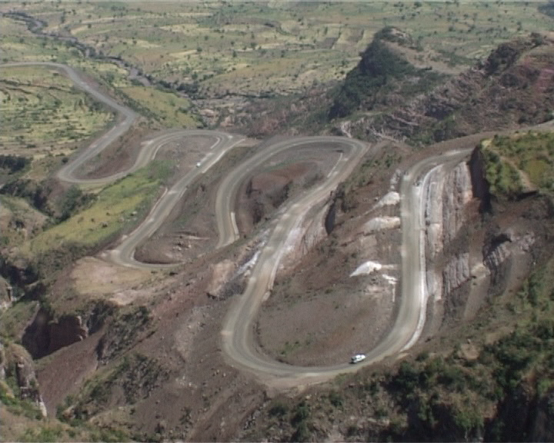
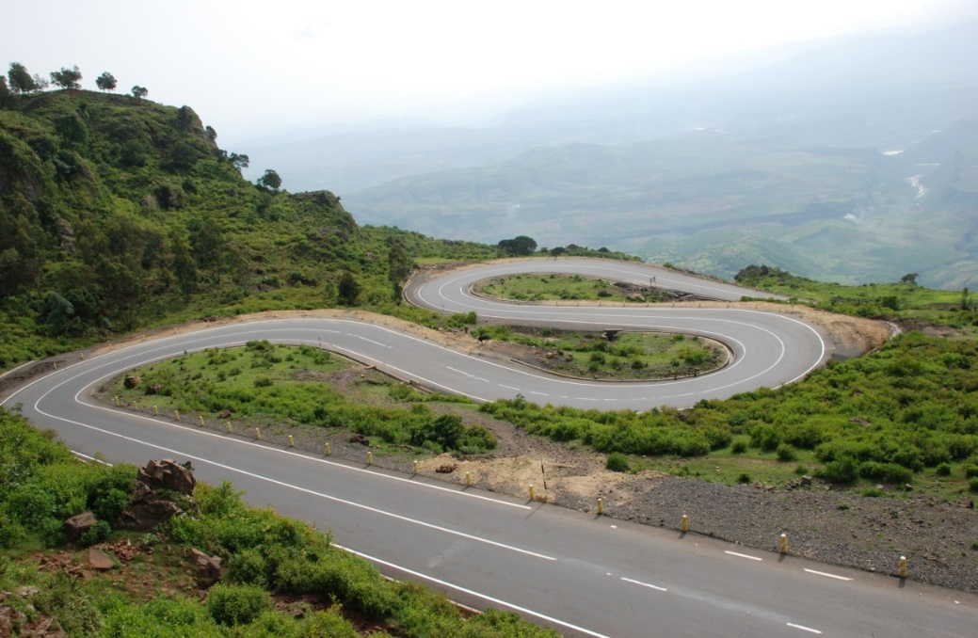
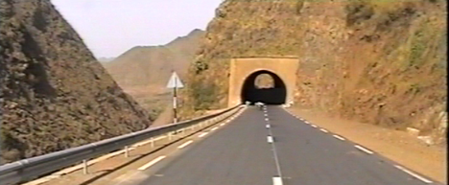
Typical Ethiopian roads
INTRODUCTION TO ETHIOPIAN BRIDGES

Slide 6
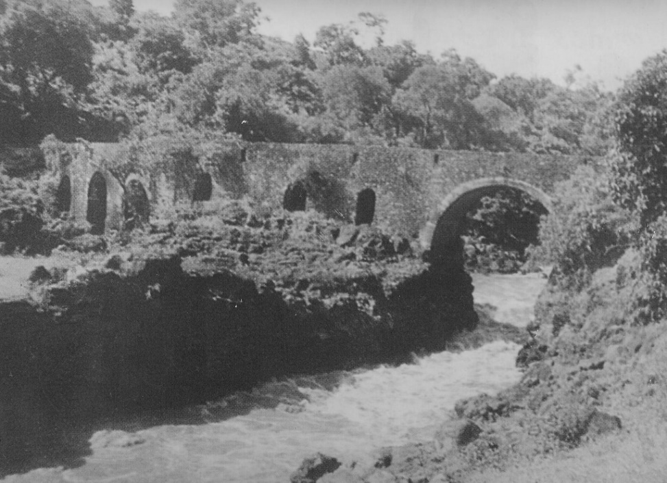
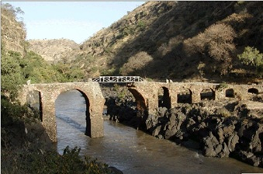
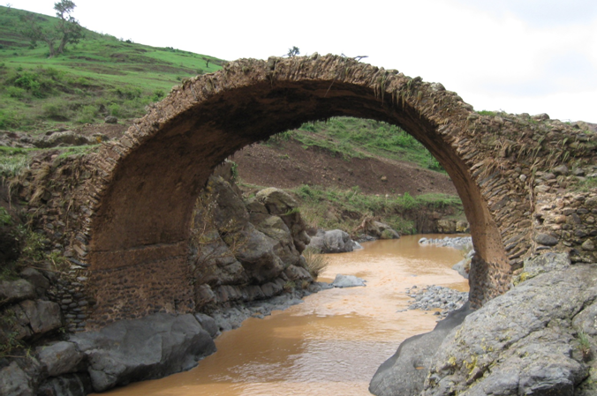
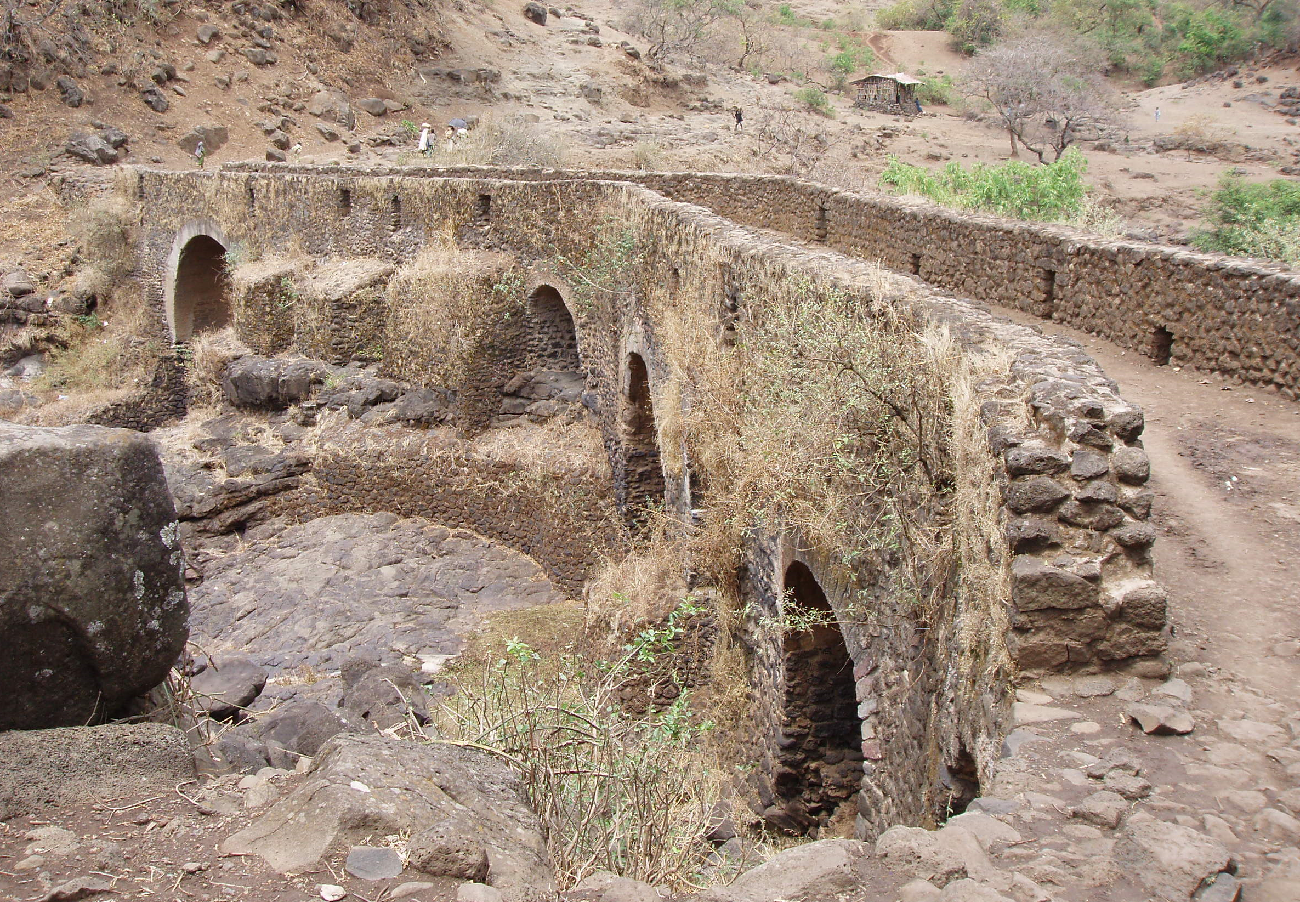
INTRODUCTION TO ETHIOPIAN BRIDGES
Ethiopian Bridges in 17th century

Slide 7
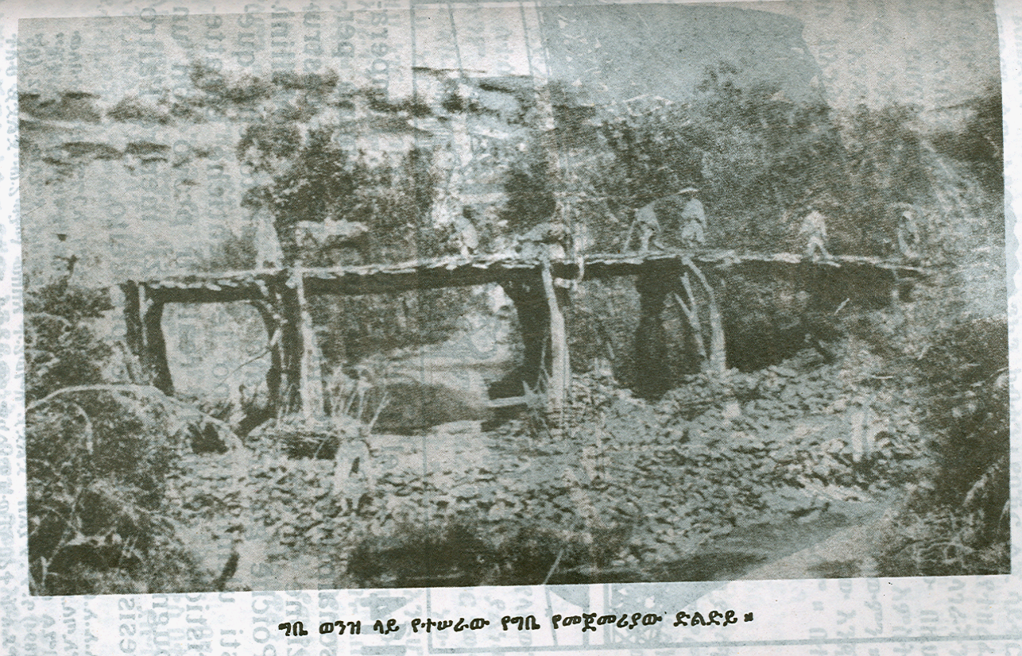
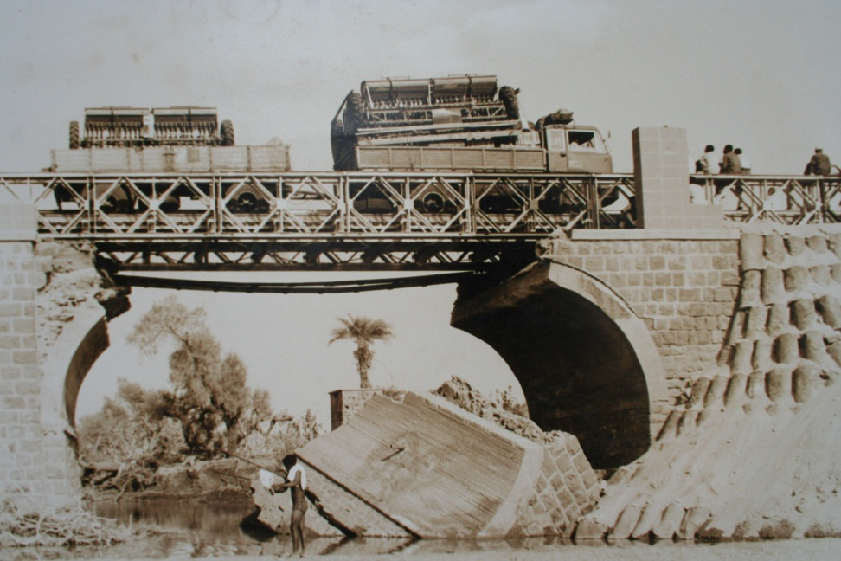
INTRODUCTION TO ETHIOPIAN BRIDGES
Ethiopian Wood and Bailey Bridges in 19th century

Slide 8
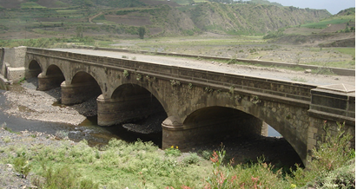
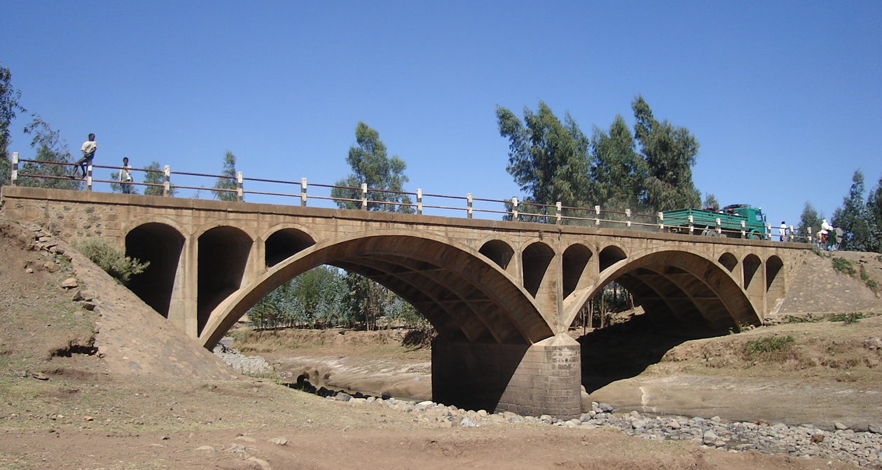
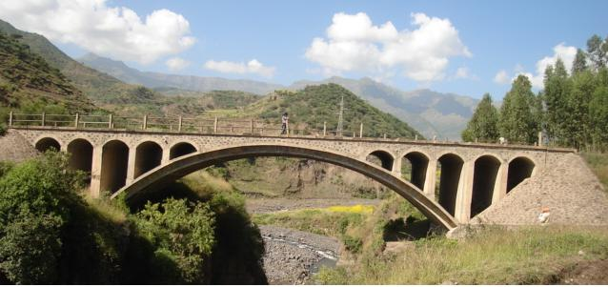
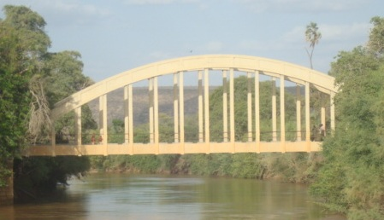
INTRODUCTION TO ETHIOPIAN BRIDGES
Ethiopian Masonry and RC Arch bridges in 20th century

Slide 9
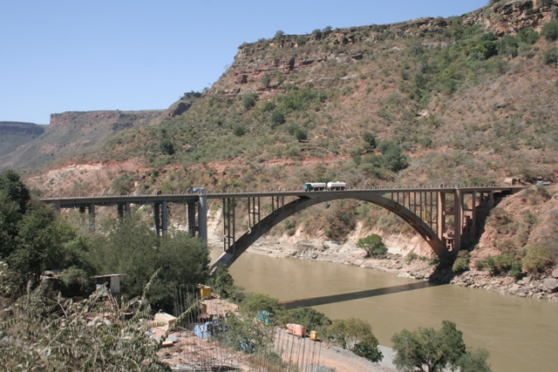
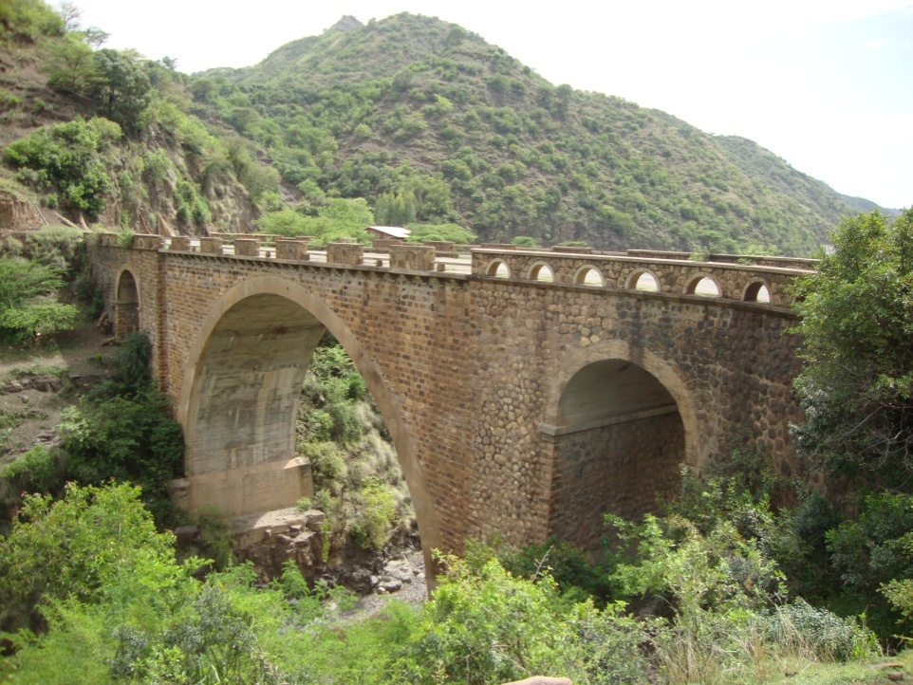
INTRODUCTION TO ETHIOPIAN BRIDGES
Ethiopian Masonry and RC Arch bridges in 20th century

Slide 10
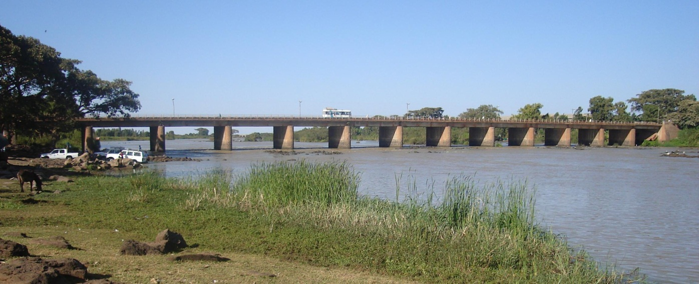
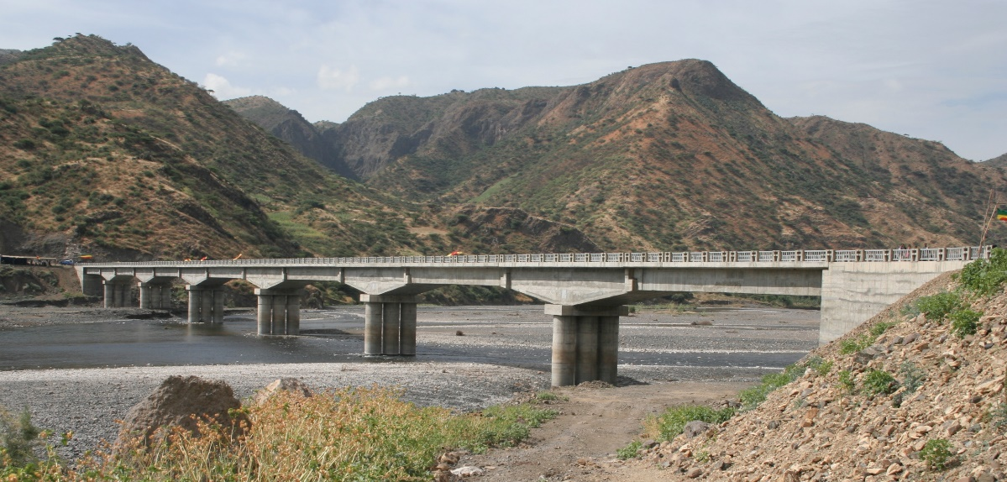
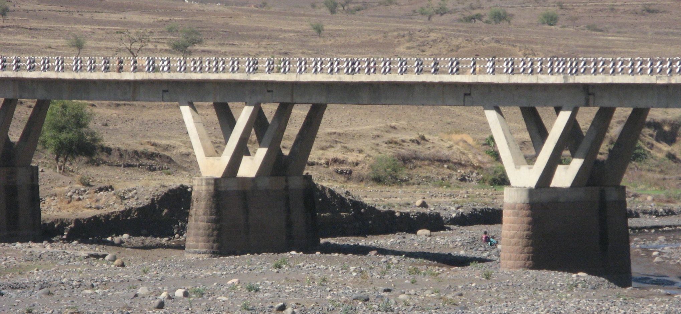
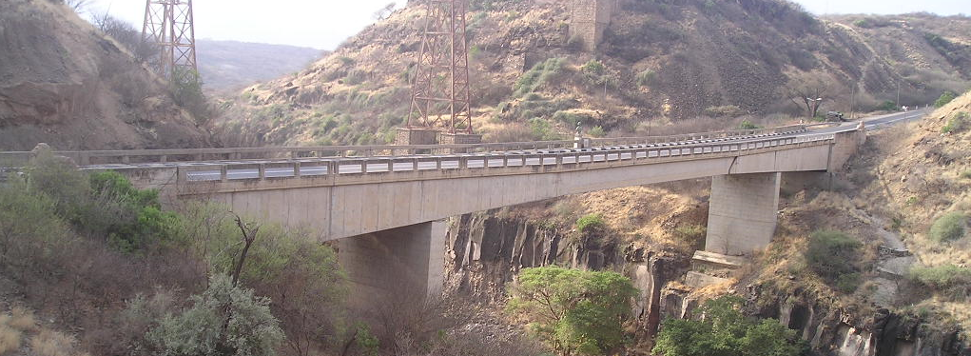
INTRODUCTION TO ETHIOPIAN BRIDGES
Ethiopian Concrete Bridges in 20th century

Slide 11
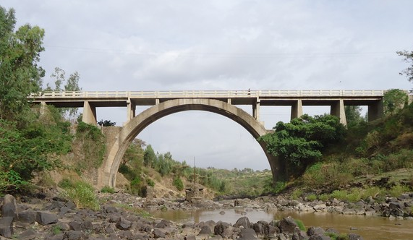
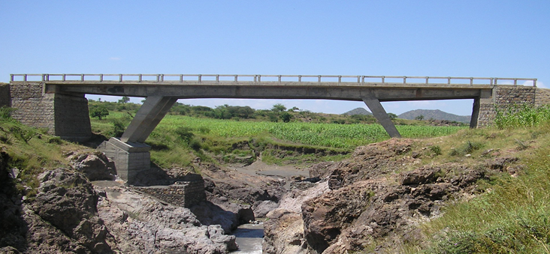
INTRODUCTION TO ETHIOPIAN BRIDGES
Ethiopian Concrete Bridges in 20th century

Slide 12
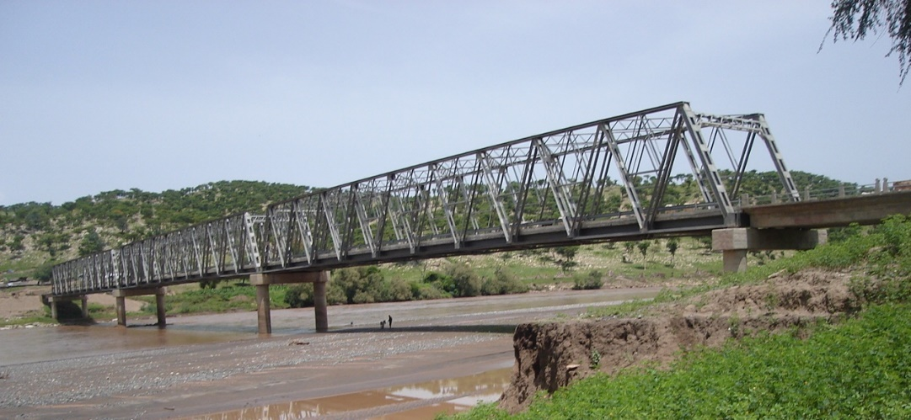
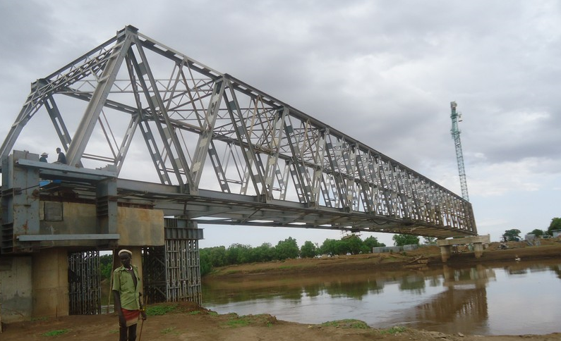
INTRODUCTION TO ETHIOPIAN BRIDGES
Ethiopian Steel Bridges in 20th century
Omo River steel bridge located 15 km to
Kenyan boarder tributary to Lake Turkana. The
longest single span steel truss bridge,
128 mt
Total length 40+128+40= 208 mt
Tekeze River steel bridge located in the
North East of Ethiopia .
Central 3 span steel truss and concrete approach
20+80+80+80+20 = 280 mt

Slide 13
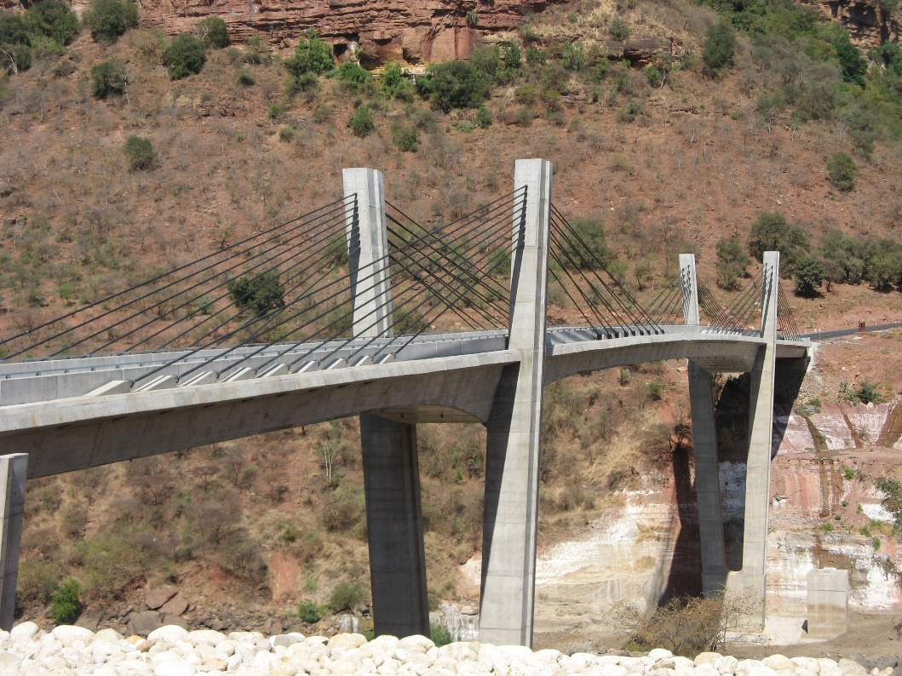
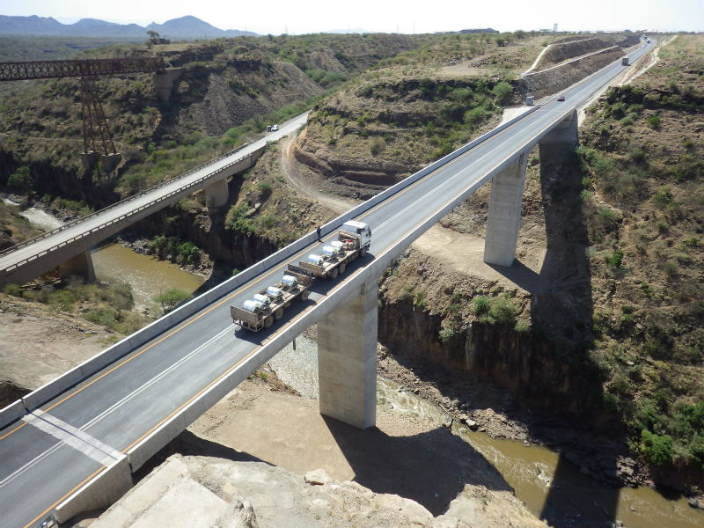
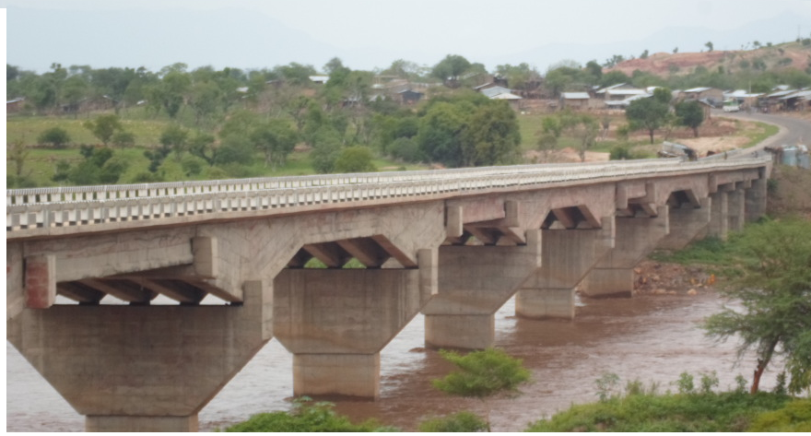
INTRODUCTION TO ETHIOPIAN BRIDGES
Ethiopian Bridges in 21th century
( August 2008 ) Abay No 6 Bridge, 303 mt, Japan grant aid
( Dec 2014 ) Awash River Bridge, 145 mt, Japan grant aid
( Dec 2004 ) Tekeze River Bridge, 440 mt,

Slide 14
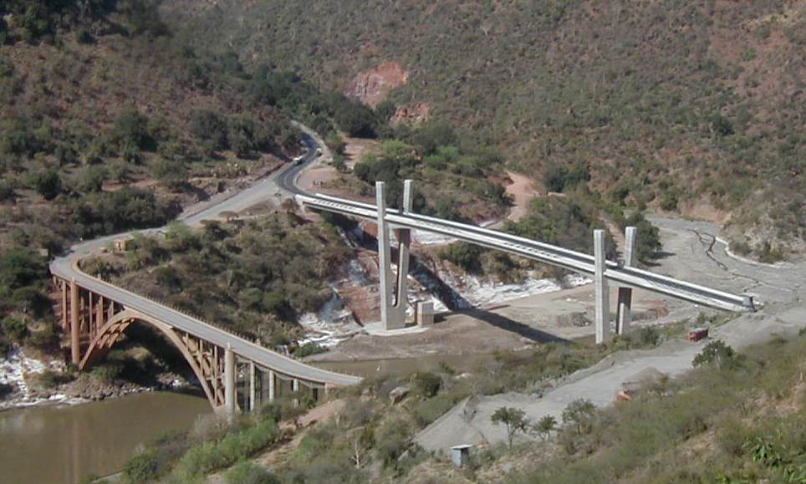
INTRODUCTION TO ETHIOPIAN BRIDGES
Symbol of modern bridges Transition from 20th to 21st century
The Blue Nile river bridge
From RC Arch bridge ( 1947) to
Extradosed dosed bridge ( 2008)

Slide 15
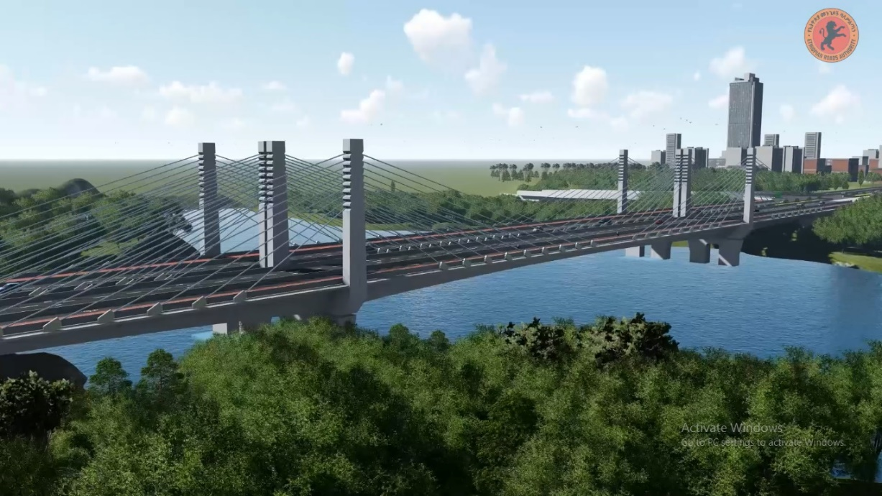
INTRODUCTION TO ETHIOPIAN BRIDGES
Best Bridge for Prosperous Ethiopia
10th bridge crossing the Abay ( Blue Nile) River
Sep 2019 – August 2022 ) 380 mt

Slide 16
INTRODUCTION TO ETHIOPIAN BRIDGES
After just 400 years since the first modern arch bridge
was constructed over the Blue Nile bridge, another modern
extradosed bridge is being constructed over same River.
An old bridge is the 1st Arch bridge and the new bridge is
10th bridge crossing this Abay ( Blue Nile) River.
These bridge are located 3 km and 33 km away from the
Famous lake Tana at Bahirdar city, which is one of the
biggest lakes in Africa.
1619
Commencement is launched on September 2019

Slide 17
Bridge Asset management and Bridge Improvement activities in ERA

Slide 18
INTRODUCTION TO ETHIOPIAN BRIDGES
Growth of bridge Stock in ERA
The first nationwide bridge Inventory and Inspection was conducted in 2006 after the in-house development of BMS software by self initiated engineers was widely introduced to the ERA management and District staff.
Major Inspection of bridges is taking place at 3 years interval and Visual inspection every year.
Condition, % | Major Inspection Year
 | 2006 | 2010 | 2013 | 2016
Good | 54 | 60 | 67 | 74
Fair | 36 | 22 | 11 | 6
Bad | 10 | 18 | 22 | 20

Slide 19
INTRODUCTION TO ETHIOPIAN BRIDGES
ERA bridges by type as of August 2019
It. No. | Type of bridges | Quantity of bridges | Total %
1 | RC Slab Culvert | 1879 | 42.91
2 | RC Deck Girder | 1215 | 27.75
3 | RC Box Culvert | 832 | 19.00
4 | Masonry Arch | 350 | 7.99
5 | RC Box Girder | 34 | 0.78
6 | Mixed | 20 | 0.46
7 | RC Arch | 16 | 0.37
8 | Steel Girder / Composite | 11 | 0.25
9 | Steel Panel / Bailey | 8 | 0.18
10 | PC Deck Girder | 6 | 0.14
11 | Steel Truss | 4 | 0.09
12 | PC Box Girder | 3 | 0.07
13 | Extrdosed | 1 | 0.02
 | TOTAL | 4379 | 100.0

Slide 20
INTRODUCTION TO ETHIOPIAN BRIDGES
Top 10 Long bridges, August 2019
It. No. | District Name | Bridge No | Bridge Name | Km from Addis | Bridge Length | Bridge Type | Construction Year | Contractor | Designer
1 | Adigrat | B107-3-038 | Tekeze | 1194.2 | 440.0 | RC Deck Girder Tappered | 2004 | SUR | UNICON
2 | Nekempt | B32-8-009 | Abay No. 7 Blue-Nile | 815.1 | 320.0 | Steel Truss and RC Deck Girder | 2010 | Syno Hydro | Carl bro / WSP
3 | Combolcha | D31-2-010 | Beshilo | 447.0 | 305.4 | RC Box girder main and RC girder approach | 2002 | Berta | TCDE
4 | Debre Markos | A3-3-001N | Abay No 6 - Hidasie | 206.1 | 303.0 | Cable/ Suspension, Extradosed | 2008 | Kajima | ORINTAL/ Japan
5 | Combolcha | B108-1-001 | Abay No 8 | 500.0 | 280.0 | PC Box Girder | 2012 | CGCOC Chinas | SCOTWILSON CONSULTING
6 | Adigrat | E27-1-020 | Tekeze No 3 | 1237.3 | 280.0 | Steel Struss Main and RCDG approach | 2001 | Solma / ERA | TCDE
7 | Jimma | B50-2-012 | Baro | 764.5 | 276.2 | RC Deck Girder | 1981 | ERA | ERA
8 | Debre Markos | B32-1-005 | Abay No.5 | 459.5 | 235.5 | PC Box Girder | 1990 | Blue Nile construction | Sir. Wiliam Halcow & Partners
9 | Soddo | C93-3-001 | Omo | 875.0 | 223.0 | RC Box Girder Main and-RCDG | 2017 | Marcan | SABA engineering/Classic
10 | Sodo | C98-1-001 | Omo (Omorate) | 860.0 | 200.0 | Steel Truss + Box Girder | 2013 | Midroc/Africon/TCL | TCDE

Slide 21
Major Activities of Bridge Management Team of ERA
INTRODUCTION TO ETHIOPIAN BRIDGES
Administer data of bridges and culverts found on Federal roads administered under ERA by using BMS software,
Coordinate and follow up regular bridge and culvert Inventory and Inspection works,
Update central Bridges and Culverts data-base in BMS software and analyze data for formulation of bridge Improvement Projects ,
Follow up Implementation of bridge improvement projects,
Revise the Master Plan for bridge improvement,
Conduct Emergency and Special bridge inspection, and
Provide bridge information, technical advice and assistance to all inside and outside of ERA sector stakeholders, and capacity building support in bridge asset administration to ERA District offices.

Slide 22
INTRODUCTION TO ETHIOPIAN BRIDGES
Major Activities of Bridge Management Team of ERA … Contd
Administer data of bridges and culverts found on Federal roads administered under ERA by using BMS software,
As the data management concept in our context is primarily administering bridge and culvert asset including acquire, validate, store, protect, and processing the required data to ensure the accessibility, reliability, and timeliness of the bridge data for users, we use the in-house developed BMS software.
According to the latest data, the total number of bridges and culverts administered by ERA is 4379 and 36022 respectively. These structures laid on about 29000 km road length in all 10 ERA branch offices. The total asset value of these structures is estimated to ETB 11.2 Bil ( 500 Mil USD).

Slide 23
INTRODUCTION TO ETHIOPIAN BRIDGES
Major Activities of Bridge Management Team of ERA … Contd
Coordinate and follow up regular bridge and culvert Inventory
and Inspection works
It is known that, the regular bridge and culvert inventory and inspection works is undertaken by BMS support consultants. The consultants carry out bridge condition survey and give technical support to the RNMDs. Since 2006, 3 rounds of this service project was running and the third round BMSS was officially completed in the month of February, 2019 G.C. The request for procurement of 4th round BMSS consultants was sent a year ago the service is expected to be commenced in December 2019.
The next service is expected to be the last one and newly assigned graduate engineers and team leaders at all branch office are expected to fully handover this task. Thus this 2 years support service is mainly focused on intensive capacity building activities. For this ERA has decided to establish a Unit at all branch office comprising at least 2 engineers and 1 data encoder.

Slide 24
INTRODUCTION TO ETHIOPIAN BRIDGES
Major Activities of Bridge Management Team of ERA … Contd
Update central Bridges and Culverts data-base in BMS software and analyze data for formulation of bridge Improvement Projects.
Update of the BMS data-base is a regular work of the team. The work volume varies from time to time. Whenever new and more reliable information is acquired from a site-visit or is received from RNMDs, the team updates the database.
As it is mentioned above there are a total of 4379 bridges and 36022 culverts are managed by bridge management team. Out of the total stock about 28% are in need of different levels of improvement the other 72% are found in GOOD condition.
Since 2013 G.C. more than one hundred (100) bridges are identified for replacement and more than 300 bridge are identified for repair.
Lists of these bridges with the required ToR and information has been sent to the Engineering Procurement Directorate for design and works procurement .
Some minor repair works are recommended to be handled by SME while other major repair works by Government construction corporation ECWC.

Slide 25
INTRODUCTION TO ETHIOPIAN BRIDGES
Major Activities of Bridge Management Team of ERA … Contd
Follow up Implementation of bridge improvement projects.
The Bridge Management Team based on the BMS out put and site findings initiates bridge improvement projects include consultancy (Design or supervision) and construction (replacement or repair) projects initiated as an intervention to improve or replace structures (bridges and culverts) administered by ERA.
In this regard, although there is a pressing need of intervention for almost 28% of the structures, most of the projects are yet to be commenced due to several reasons including the following;
A very slow procurement process
Very few contractors are interested in bridge repair and construction works
The following are the main updates regarding procurement of bridge improvement projects;
Tender has been floated for design projects of 62 + 15 bridges. Technical documents submitted by interested bidders and this is now under evaluation.
The bid floated for the 21 bridge projects with DB delivery system and at same time negotiation is under going with some government contractors for direct award .
More than 330 Bridge, which are in need of minor and major repair works are under negotiation to include in road heavy maintenance projects.
Due to these long time taking attempts , there is worry condition of these bridges is deteriorating from time to time and collapse may occur at any time.

Slide 26
INTRODUCTION TO ETHIOPIAN BRIDGES
Major Activities of Bridge Management Team of ERA … Contd
Revise / Prepare Master Plan for bridge improvement.
The first ever Master Plan for bridge improvement was issued in May 2011 after the in house developed BMS was very well disseminated to all ERA branch offices and private consultants as well as after 2 rounds of nation wide bridge inventory and inspection was conducted.
Due to the fact that many uncertainties and assumptions were there while preparing the first MP, only about 55% of the plan could be achieved. Lessons are taken since start of its implementation in the process of evaluation of the past achievements and drawbacks seen.
Among many reasons,
shortage of skilled and experienced manpower in bridge repair works, preparation of the right work order by following the bridge repair manual and use of repair specification for supervising the work procedure,
Slow procurement process for design and construction and less interest of contractors,
Shortage of specialized tools and materials required for repair works like epoxy resin and others can be mentioned as dominant and critical obstacle to the desired achievements.
In fact our team was continuously revising the MP in 5 years implementation period and trying to include bridges in some road improvement projects.
Currently we are revising total achievements in the past years and preparing the 2nd MP for bridge Improvement works.

Slide 27
INTRODUCTION TO ETHIOPIAN BRIDGES
Major Activities of Bridge Management Team of ERA … Contd
Conduct Emergency and Special bridge inspection
Emergency Inspection is conducted whenever required. Most of the time after natural disaster and sever traffic accidents emergency inspection may be conducted. The purpose of this inspection is to provide information on structural safety and safe traffic condition in the process of assisting ERA branch ofices.
Since the past 15 years many bridges located along Trunk roads are suffering from heavily loaded trucks due to economic growth requirements. ERA frequently receives permit request letters from different importers and transporters and that puts ERA in difficult situation to grant permission.
However, usually, requesters are recommended to conduct structural capacity analysis and submit to ERA for comment before permission, ERA bridge team has decided to involve it self in such analysis tasks and have reliable data for all strategic bridges.
In this year, in cooperation with AAU bridge engineers, in support of the WB office, study, analysis and use of bridge rating software was conducted to determine residual bearing capacity for selected 32 in service bridges located along Addis – Galafi and Modjo – Sodo road segments, which are import-export corridors and highly vulnerable to heavy trucks.
As a result, load limit precautions and pass procedure is set for 7 critical bridges based on the acquired capacity. Permit truck type and load limit is decided.

Slide 28
INTRODUCTION TO ETHIOPIAN BRIDGES
Major Activities of Bridge Management Team of ERA … Contd
Provide bridge information, technical advice and assistance, and capacity building support in bridge related
This task is one of the services being rendered regularly by the Team to different ERA offices, Management body, stakeholders, Universities and the public in general with regard to bridge and related works.
Beneficiaries of this service are :-
ERA management body for budget and project issue decision purposes,
ERA branch office in all Districts,
Engineering office of ERA for procurement and project management ,
ERA Legal departments,
Post graduate students from Universities,
Regional Government Road authorities,
Local and foreign Design and Construction firms,
Any Information seeker stakeholders, etc

Slide 29
INTRODUCTION TO ETHIOPIAN BRIDGES
Facts on Bridge asset management activities
The Road Sector Development Program ( RSDP ) , which was launched in Ethiopia in 1997 highly suffered from lack of data and information about Ethiopian bridges` condition while formulating road rehabilitation projects.
Since then, importance of having Bridge database in ERA was considered as vital to achieve what was envisaged in consecutive plans of the RSDP.
In 2002, a self initiated Engineers started development of Bridge Management System ( BMS ) software and widely introduced concept of bridge asset management to ERA Engineers and managers.
Then office of Bridge works was separated from Operations Department and newly established under the Road Network management Department as Bridge Management Branch.
JICA as partner of RSDP, assisted ERA in development of Bridge Inspection Manual ,which is an important tool to conduct bridge service condition survey.

Slide 30
INTRODUCTION TO ETHIOPIAN BRIDGES
Facts on Bridge asset management activities
The in house developed BMS software was completed and officially accepted by ERA management in 2004.
Under the Technical Assistance rendered by JICA a number of Engineers from ERA and RRAs received intensive on the job training on bridge Inventory, Inspection, Repair and asset Management. This field is not common in local Universities in undergraduate programs.
After basic requirements, platforms and ground works like assuring availability of working BMS software for database establishment, Bridge Inspection manual and trained Inspectors, are well prepared , the First ever in Ethiopia Nationwide Bridge Inventory and Inspection project was launched In 2005.
At the end of 2006 ERA could own for the first time well organized Bridge and Culvert information and data.
The data and information covers Physical, Geometrical, Structural, Geographical, Historical and more importantly service condition.

Slide 31
INTRODUCTION TO ETHIOPIAN BRIDGES
Facts on Bridge asset management activities
The 1st Inventory and Inspection project revealed that there are 2954 bridges and 18000 Culverts under ERA administration.
Among these bridges only 54% were found in ``GOOD`` Service condition and the rest in need of different level of interventions.
Prioritization list for replacement and repair of Bridges was prepared .
Basic prioritization criteria for replacement was
Damage and defect severity level obtained by BMS after inspection,
Age and road class,
Bridge length , long bridges with no detour possibility,
Old arch bridges constructed during Italian Invasion,
Bridges prone to accident and located along sharp curves,
Temporary Steel / Bailey bridges,
Bridges located along the roads having high traffic volume, and
Overtopping of culverts.

Slide 32
INTRODUCTION TO ETHIOPIAN BRIDGES
A number of bridges and culverts are included in different Road rehabilitation projects based on the intervention requirement level. By doing this, the RSDP steps ahead in terms of considering bridge structures by name and specific location.
Importance of updating the bridge database by conducting regular inspection and allocation of dedicated budget for bridge repair works becoming considered.
In this respect, the Road Fund Office is Yearly allocating budget for bridge inspection since 2006 and for bridge repair since 2011.

Slide 33
INTRODUCTION TO ETHIOPIAN BRIDGES
In 2011, a well organized Master Plan for bridge rehabilitation was issued.
The Master Plan envisaged to achieve after 5 Years:-
Bring 52.2% Good condition to 80% .
Have more modernized database manipulating BMS
Build capacity of Engineers in bridge inspection and repair works for the sector as a whole. ( established and involved SME contractors, many engineers attracted to bridge sector and did their postgraduate paper in the field)
Based on the Master Plan, list of bridges are being sent to Engineering Procurement for replacement and repair tendering.
List of all ongoing bridge projects ( Design, Construction and Repair) is available in Bridge Management Team for performance follow-up and data update.

Slide 34
INTRODUCTION TO ETHIOPIAN BRIDGES
Impacts of BMS in ERA
Availability of well organized system for bridge asset management that is advanced tool for decision makers on formulation of bridge improvement projects.
Since 2006:-
All bridges and Culverts are visually inspected once per year,
All bridges and Culverts are inspected in detail for service condition, rated and prioritized at every three years interval.
Bridge and culvert Inventory is conducted when ever new bridge and new roads are introduced to the network.
All bridges and Culverts are registered by Name, Id Number, spacial location data as well as pictures, videos and drawings
List of prioritized bridges for improvement is always available
Stakeholder, at any level, can obtain any kind of current data and information about bridges in ERA.

Slide 35
INTRODUCTION TO ETHIOPIAN BRIDGES
Impacts of BMS in ERA
More than 90% Temporary Bailey bridges are replaced by permanent concrete bridge. Currently No Bailey bridge on Trunk and Main roads.
Significant number of Engineers received short term training on bridge Inspection and repair, which is not available in local Universities.
These trained and familiar with BMS engineers are widely engaged in bridge inspection and repair works.
Some are given minor bridge repair projects by ERA under Small-scale Enterprises organized by Regional Governments.

Slide 36
INTRODUCTION TO ETHIOPIAN BRIDGES
Budget allocated for bridge INSPECTION Mil Br

Slide 37
INTRODUCTION TO ETHIOPIAN BRIDGES
EFY Budget allocated for bridge Repair Mil Br

Slide 38
INTRODUCTION TO ETHIOPIAN BRIDGES
Budget allocated for bridge CONSTRUCTION Mil Br

Slide 39
INTRODUCTION TO ETHIOPIAN BRIDGES
Problems for slow bridge improvement achievement
Very slow procurement process due to project priority and time taking procedures to award,
Non responsiveness of Designers and Contractors,
Poor capacity, experience and negligence of Designing firms,
Lack of experienced engineers from ERA side to review and comment design and other Engineering documents on time,
Poor Project management of bridge Contractors,
Delay in payment release from ERA side,
Lack of interest to carry out bridge projects due to small quantity of the work,
Re tendering of bridge construction projects due to termination, etc
Less attention for bridge asset management at District level but, more for routine road maintenance activities.

Slide 40
INTRODUCTION TO ETHIOPIAN BRIDGES
Due to the above mentioned facts the bridge replacement and improvement plan is not achieved as desired and the ``Bad`` condition remain growing.
Despite that , many bridges and structures are replaced and improved under Road rehabilitation projects and Individual long bridge projects as well as new bridges are introduced along with the road network expansion. Therefore, ``Good`` condition of bridges could reach to 74% in 2016.
Condition, % | Major Inspection Year
 | 2006 | 2010 | 2013 | 2016
Good | 54 | 60 | 67 | 74
Fair | 36 | 22 | 11 | 6
Bad | 10 | 18 | 22 | 20

Slide 41
The way forward Enhancement of Bridge asset mgt activities
INTRODUCTION TO ETHIOPIAN BRIDGES
Upgrade the existing Bridge Management System ( BMS ) to web-based application to easily access the updated information and minimize the data entry errors,
Revise the Bridge Improvement master plan and Continue Prioritization of bridges for intervention,
Support Engineering Procurement and Design directorates in formulation and implementation of bridge projects,
Continue conducting bridge inspection and inventory works as well as enhance bridge inspection methods ( drones ,scoopers and other tools)
Intensify recently started bridge rating and evaluation activities for in service Bridges , ( use rating software, load and impact measuring tools, etc)
Upgrade Bridge asset value determination activities,

Slide 42
The way forward Enhancement of Bridge asset mgt activities
INTRODUCTION TO ETHIOPIAN BRIDGES
Continue capacity building works for ERA Branch offices. Establish bridge mgt Units ,
Continue insisting the concerned ERA mgt and Government bodies for formation of specialized contractors for bridge construction and repair works,
Conduct wide range studies in climate change impacts on bridge structures and work on other better asset management suggestions,
Work with supporting international partners to enhance the bridge asset mgt works ( Volunteers and TA projects) ,
Finalize BRICES software for bridge construction cost estimation,
Continue promoting ERA`s activities in bridge field by using ERA magazine, webpage, conferences and other available medias as well as work to introduce ERA in international associations like PIARC and IRF.

Slide 43
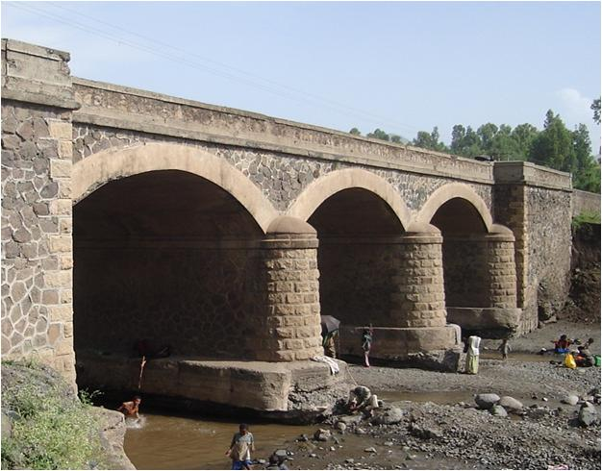
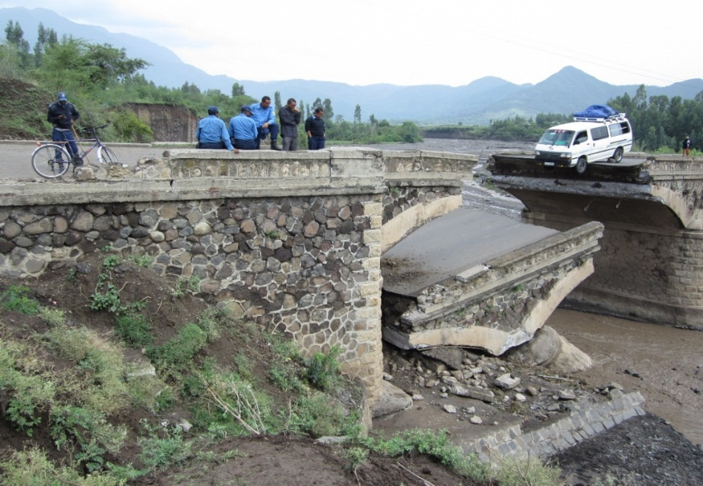
INTRODUCTION TO ETHIOPIAN BRIDGES
Revise the Bridge Improvement master plan and
Continue Prioritization of bridges for intervention
Bridge performance Indicator due to lack of timely repair

Slide 44
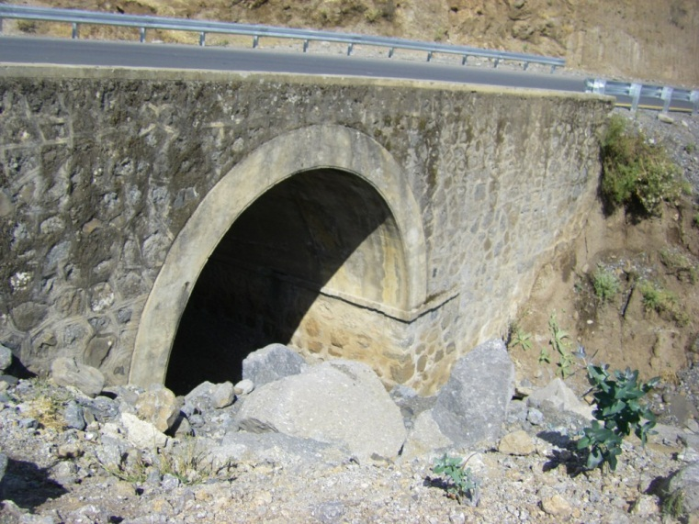
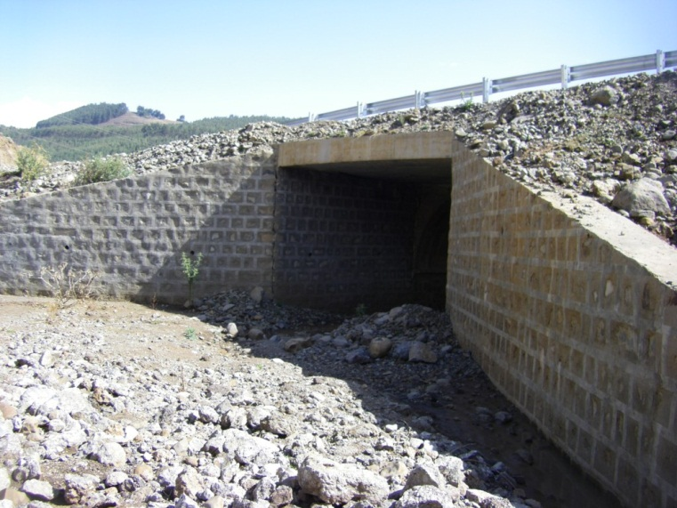
INTRODUCTION TO ETHIOPIAN BRIDGES
Replacement of an Old Arch bridges
Many old Masonry bridges are being replaced based on the BMS top priority set up due to aging , under capacity to the current traffic load, sudden collapse in rainy season, being located at sharp curves , etc
21% From the total stock 8%

Slide 45
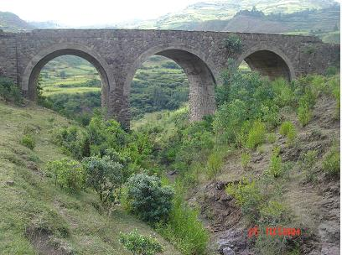
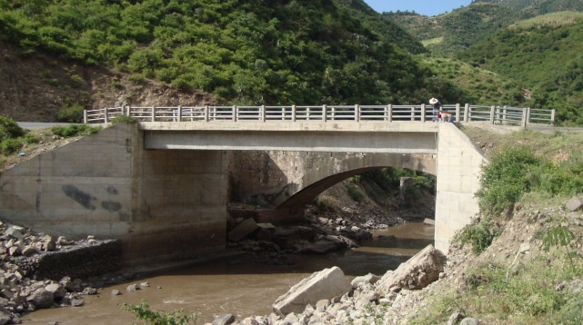
INTRODUCTION TO ETHIOPIAN BRIDGES
Replacement of an Old Arch bridges

Slide 46
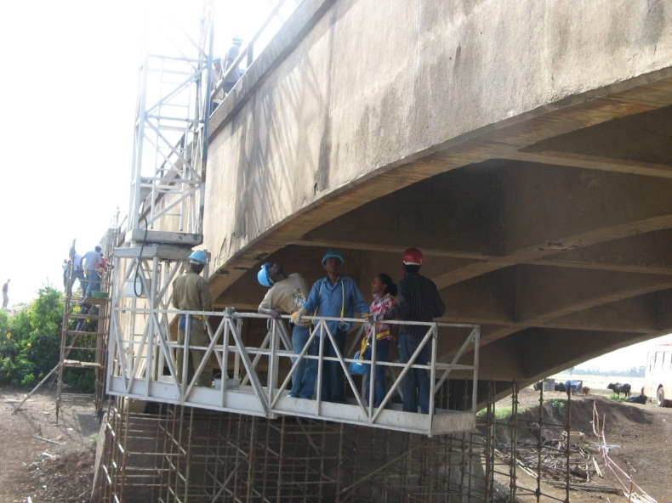
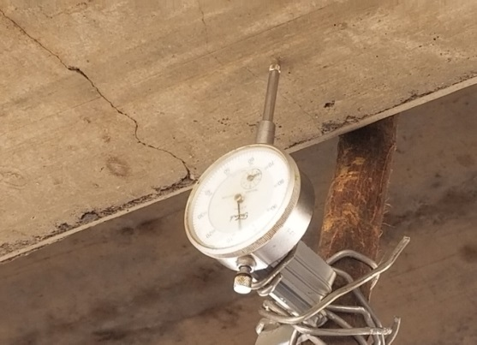
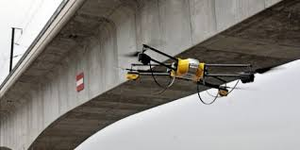
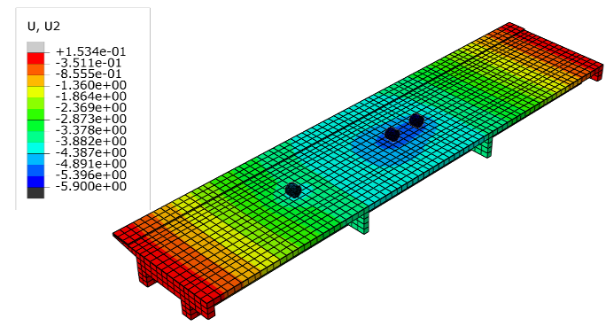
INTRODUCTION TO ETHIOPIAN BRIDGES
Enhance bridge inspection and Evaluation methods
Drone-enabled bridge inspection
Deflection measuring gauge
Bridge rating and evaluation

Slide 47
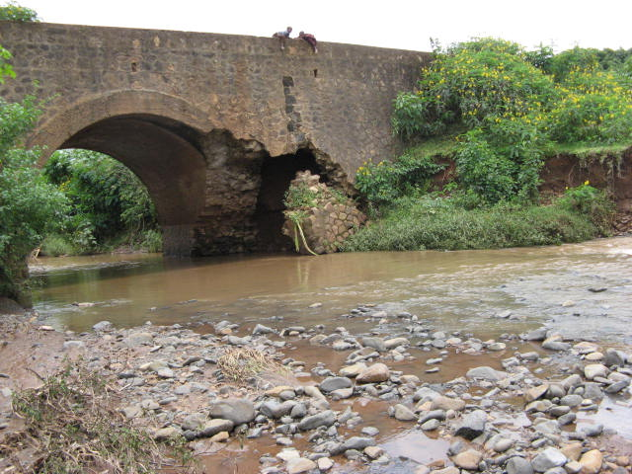
INTRODUCTION TO ETHIOPIAN BRIDGES
The most prevalent defects and damages of Ethiopian bridges are due to
SCOURING and OVERLOADINGS

Slide 48
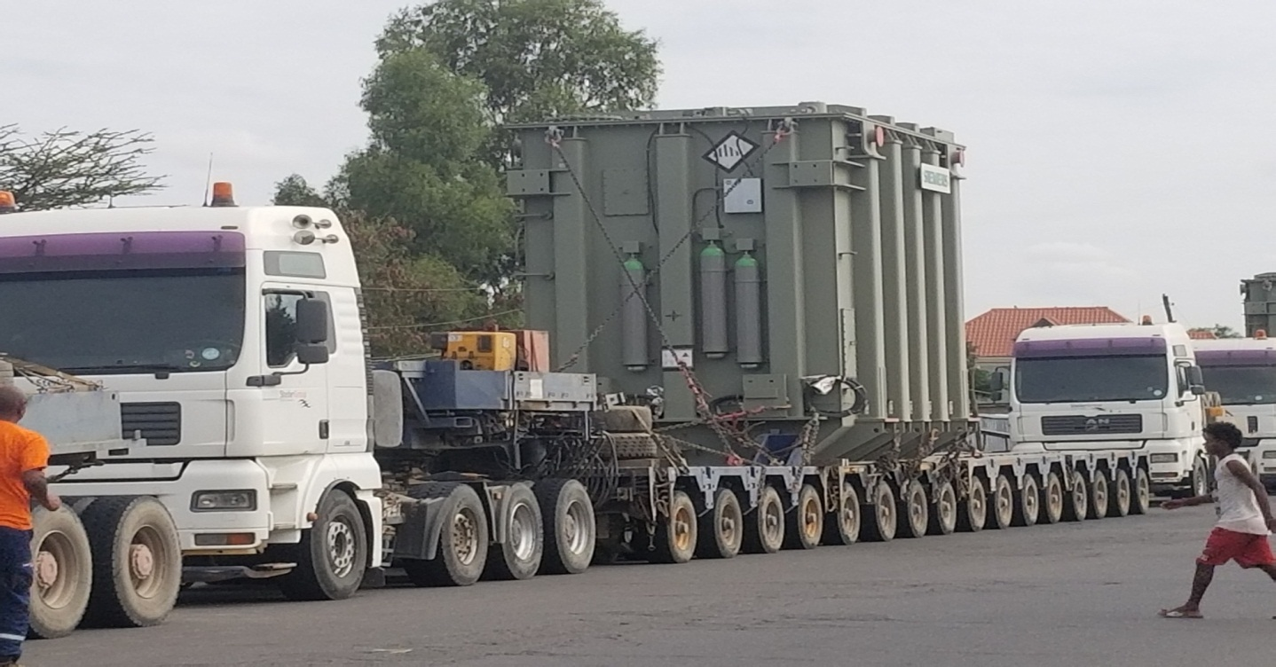
INTRODUCTION TO ETHIOPIAN BRIDGES
The most prevalent defects and damages of Ethiopian bridges are
SCOURING and OVERLOADINGS

Slide 49
አመሰግናለሁ Thank you

